Slide 1


Carpentries
DATA + SOFTWARE SKILLS FOR LIBRARIANS
Library Carpentry Workshop
May 11–20, 2026 | 9:00 am – 12:00 pm PT

Slide 2

HOW WE LEARN TOGETHER
OUR PEDAGOGY
MANAGING EXPECTATIONS
▪
Live Coding: We learn by doing together; mistakes are pedagogical opportunities.
▪
Practical Competence: Skills you can apply immediately in your library role.
▪
Collaborative Pace: We move as a group; your questions help set the speed.
▪
Mental Models: Building understanding by connecting new skills to your daily work.
▪
Mistakes are Expected: Coding is a process of troubleshooting and persistence.
▪
No Overload: We focus on a few key concepts to ensure mastery over speed.

Slide 3

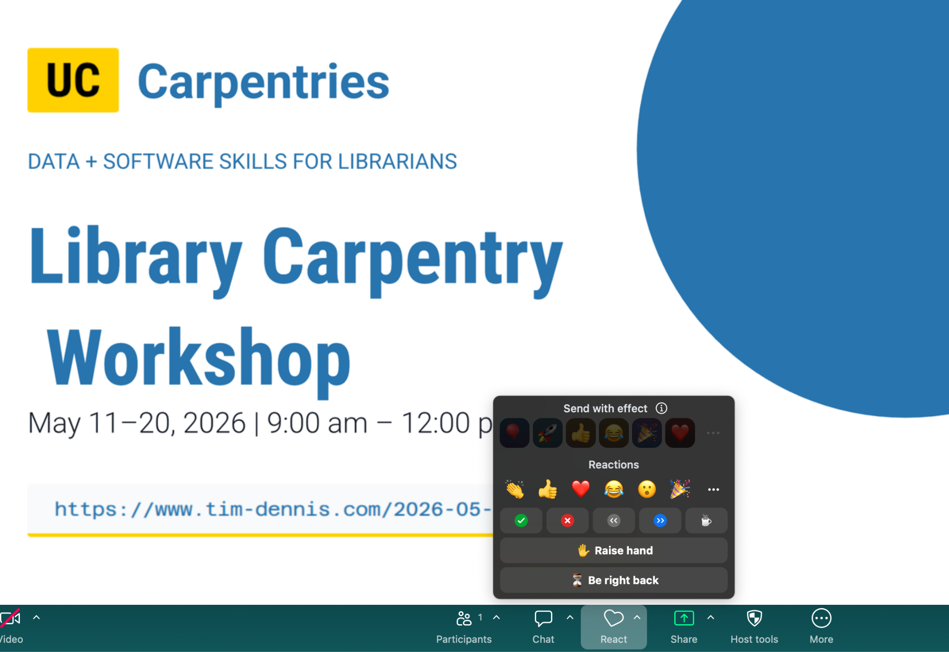

ZOOM TOOLS & SUPPORT
ZOOM ETIQUETTE
Raise Hand for verbal questions
Use Chat for technical issues & help
Use Non-verbal icons (Yes/No/Speed)
COMMUNICATION
Post questions in Etherpad shared notes
Helpers monitor chat for immediate aid
Typing "I'm stuck" is a complete sentence

Slide 4
WORKSHOP NORMS
BE CONSTRUCTIVE
WHAT IS NOT OK
Respect others’ time and learning pace
Repeatedly interrupting or redirecting
Let instructors guide the session flow
Dominating the discussion or focus
Maintain inclusive and welcoming language
Dismissing others or the core material
Show courtesy and respect towards community members
"We focus on creating a supportive environment where everyone feels comfortable learning."
We follow The Carpentries Code of Conduct.
If something feels off, message us privately.

